Slide 1
A3.3.2 Construct queries between two
tables in SQL
Lesson 1

Slide 2




Do Now Activity (5 mins)
What SQL keyword do you use to specify the columns you want to retrieve (e.g., FirstName, Email)?
What SQL keyword do you use to specify the table you want to get data from?
Write the complete SQL query to select only the ProductName and Price from a single table named Products.
TOK
Social media sites use databases
to store masses of data points
identifying users’ likes and dislikes.
Online shops use databases
to store numerous data points
identifying consumer likes and
dislikes. To access this data and
make it useful, companies need to
manipulate the data using specialist
language.
To what extend to a shared code
and language, such as those in the
SQL language, help or hinder the
pursuit of knowledge on a global
level?
Learning Intention: To learn how to retrieve and combine data from two separate, related tables using SQL JOIN queries.
Success Criteria:
I can identify the Primary Key and Foreign Key that link two tables.
I can write a SELECT statement that uses an INNER JOIN... [and] use the ON keyword.

Slide 3
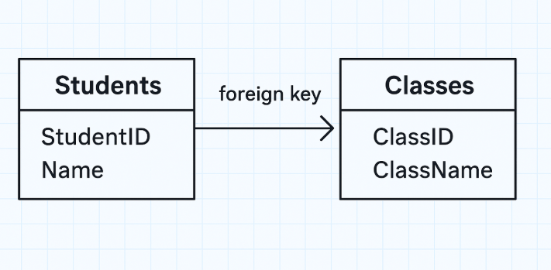
Query
In SQL, a query is a command you send to a database to either retrieve information or perform an action.
Think of it as asking the database a specific question. SQL (Structured Query Language) is the language you use to write that question.
The most common type of query is a SELECT statement, which is used to retrieve data.
How a Basic Query Works
A query is built with a few key commands:
SELECT: Tells the database what columns (data) you want to see.
FROM: Tells the database which table to look in.
WHERE: (Optional) Filters your results to only show rows that match a specific condition.

Slide 4
Example
Imagine you have a table named Users that looks like this:
Your Question: "Can I get the first names and last names of all users who live in 'New York'?"
Your SQL Query:
SQL
SELECT FirstName, LastName
FROM Users
WHERE City = 'New York';
SELECT FirstName, LastName... (Here's what I want)
FROM Users... (Here's where to look)
WHERE City = 'New York'... (Here's the filter to apply)
This query would return only the rows for John Doe and Jane Smith.
While retrieving data with SELECT is the most common use, queries can also be used to:
INSERT: Add new data.
UPDATE: Change existing data.
DELETE: Remove data.

Slide 5
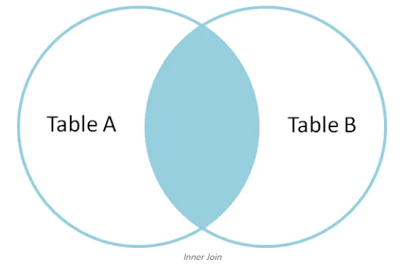
SQL INNER JOIN
The INNER JOIN keyword selects all rows from both the tables as long as the condition is satisfied. This keyword will create the result set by combining all rows from both the tables where the condition satisfies i.e value of the common field will be the same.
Syntax:
SELECT table1.column1,table1.column2,table2.column1,.... FROM table1 INNER JOIN
table2 ON table1.matching_column = table2.matching_column;
Note: We can also write JOIN instead of INNER JOIN. JOIN is same as INNER JOIN.

Slide 6
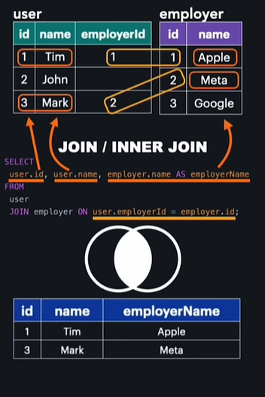

Slide 7
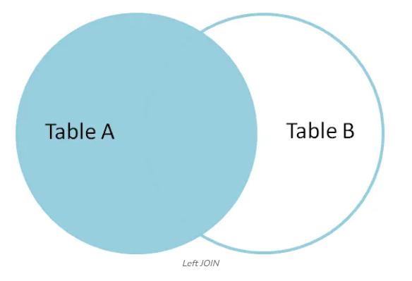
SQL LEFT JOIN
A LEFT JOIN returns all rows from the left table, along with matching rows from the right table. If there is no match, NULL values are returned for columns from the right table. LEFT JOIN is also known as LEFT OUTER JOIN.
Syntax
SELECT table1.column1,table1.column2,table2.column1,....
FROM table1
LEFT JOIN table2
ON table1.matching_column = table2.matching_column;
Note: We can also use LEFT OUTER JOIN instead of LEFT JOIN, both are the same.

Slide 8
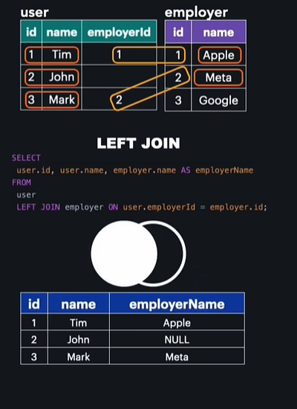

Slide 9
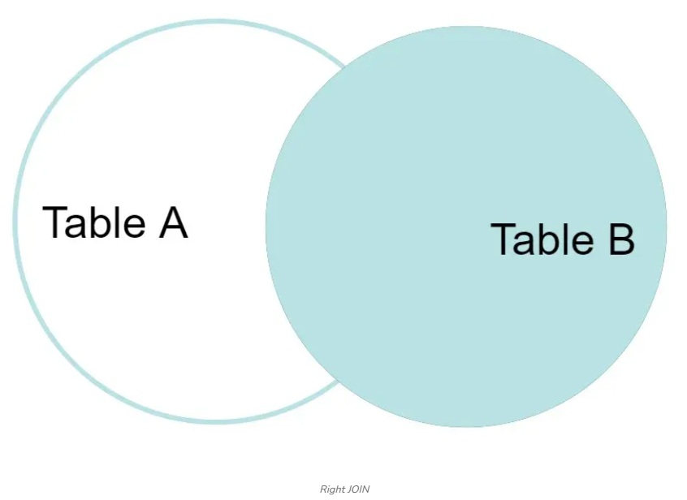
SQL RIGHT JOIN
RIGHT JOIN returns all the rows of the table on the right side of the join and matching rows for the table on the left side of the join. It is very similar to LEFT JOIN for the rows for which there is no matching row on the left side, the result-set will contain null. RIGHT JOIN is also known as RIGHT OUTER JOIN.
Syntax
SELECT table1.column1,table1.column2,table2.column1,....
FROM table1
RIGHT JOIN table2
ON table1.matching_column = table2.matching_column;
Key Terms
table1: First table.
table2: Second table
matching_column: Column common to both the tables.
Note: We can also use RIGHT OUTER JOIN instead of RIGHT JOIN, both are the same

Slide 10
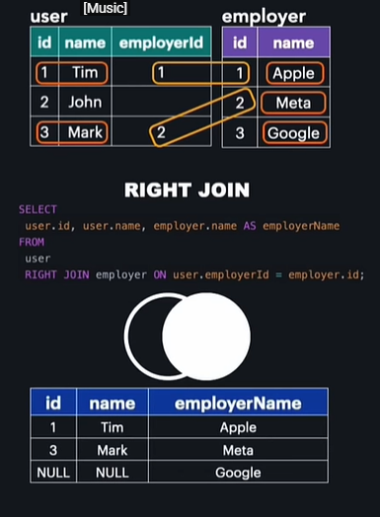
RIGHT JOIN Example
In this example, the RIGHT JOIN retrieves all rows from the StudentCourse table and the matching rows from the Student table based on the ROLL_NO column.

Slide 11
Table 2
Table 1
StudentID (PK) | FirstName | LastName | AdvisorID (FK)
101 | Ananya | Sharma | 20
102 | Ben | Carter | 10
103 | Chloe | Davis | 20
104 | David | Kim | 30
105 | Emily | Fan | NULL
AdvisorID (PK) | AdvisorName | Department
10 | Mr. Krum | History
20 | Ms. Pince | Science
30 | Dr. Flitwick | English
40 | Prof. Sprout | Biology

Slide 12
Question 1: INNER JOIN
a) Identify the primary key and the foreign key that would be used to join the Student and Advisor tables.
Primary Key: Advisor.AdvisorID Foreign Key: Student.AdvisorID
b) Construct an SQL query to display the FirstName and LastName of every student, along with the AdvisorName for each student. Only students who have an assigned advisor should be included.
cI) State the number of records that would be returned by the query in part (b).
❓ Question 2: LEFT JOIN
a) A query is needed to create a complete list of all students, showing their FirstName and AdvisorName. If a student does not have an advisor, their name should still be in the list.
Construct the SQL query to produce this report.
b) State the output of your query from part (a), based on the sample data.

Slide 13
Question 3: RIGHT JOIN
a) Explain the difference between the results of an INNER JOIN and a RIGHT JOIN when applied to the Student and Advisor tables.
b) Construct an SQL query that lists all advisors and the FirstName of any students they advise. The list must include advisors who do not currently advise any students.
c) State the name of the advisor who will appear in the query result from part (b) but will have a NULL value in the FirstName column.
❓ Question 4: Analysis
The following SQL query is executed:
SQL
SELECT Student.FirstName, Advisor.AdvisorName
FROM Student
LEFT JOIN Advisor
ON Student.AdvisorID = Advisor.AdvisorID;
a) State the name of the student whose AdvisorName will be NULL in the output.
b) Describe how the output would change if LEFT JOIN was replaced with INNER JOIN.
c) Describe how the output would change if LEFT JOIN was replaced with RIGHT JOIN.

